Slide 1
EMAIL SPAM PREDICTION
Name: Gaurav Gupta
Roll No: 1901068

Slide 2
Problem Statement
We have to create a Machine Learning Model that can Classify the Spam and Ham(Not Spam) Emails.

Slide 3
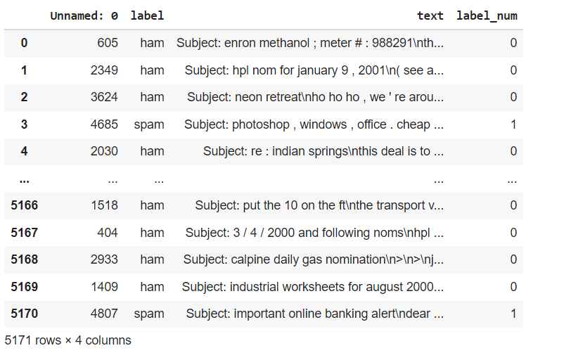
About the Dataset
The Dataset used in this project is a CSV format file containing 5171 emails with 71% not Spam emails and the remaining 29% Spam emails.
The Data Frame generated is as :

Slide 4
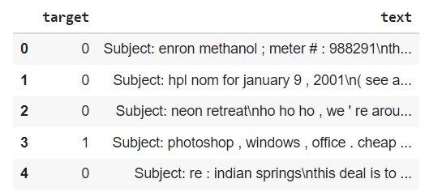
Minimizing the Dataset
The Original Data Frame consisted of 4 Columns. So I reduced it into just 2 Columns one for the text and other for the Target or the Label.

Slide 5
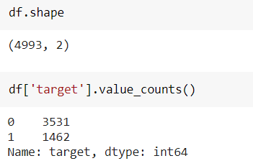
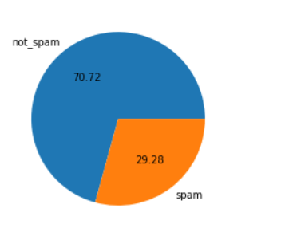
Data Cleaning
To Clean the Data Set I removed the Missing Values and also removed the Duplicate items.
Finally the Data Set looked like this

Slide 6
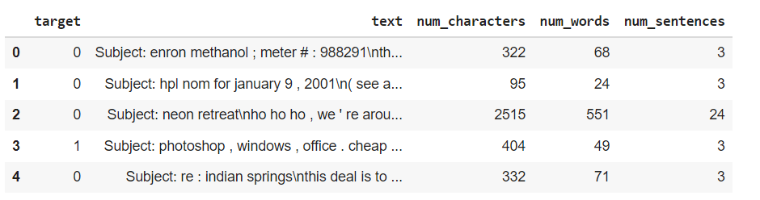
Data Analyzing
Now we analyze the Emails by checking the no of words, characters, sentences in each email.

Slide 7
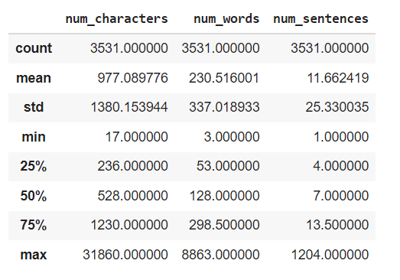
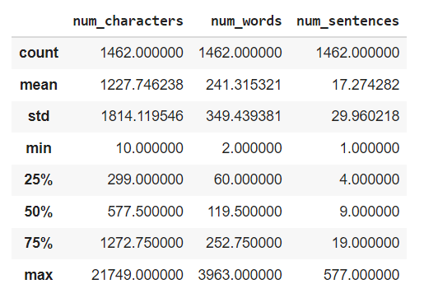
Ham Emails
Spam Emails

Slide 8
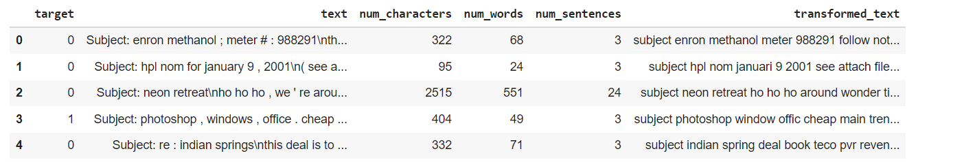
Data Preprocessing
Data Preprocessing includes :
Lower Case
Tokenization (Converting Sentences into words)
Removing Special Characters
Removing Stop words and Punctuations
Stemming (Removing similar Words)

Slide 9
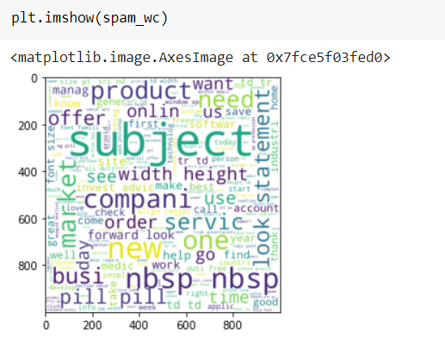
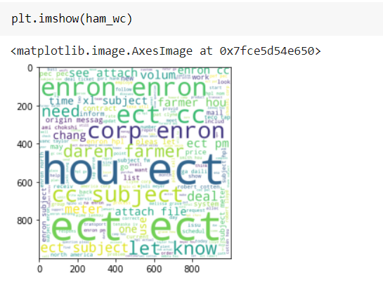
Analyzing Similarities in Data
Now we analyze the Frequent words in Spam and Ham Emails

Slide 10
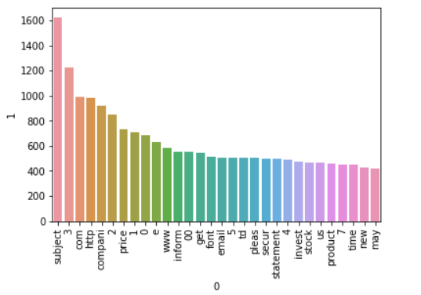
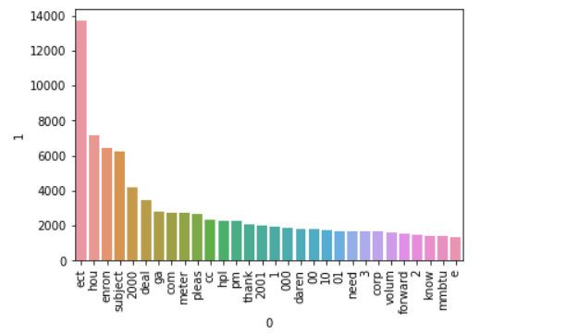
Spam Emails
Ham Emails

Slide 11
Model Building
This consists of three major parts:
Vectorizing the Data: We separate each of the transformed text into a list of words. This can be done with Count Vectorizer or TFIDF Vectorizer. In this Project I have used the TFIDF vectorizer as it gave me better results.
Splitting the Data Set: Now as we Split the Data set into Test Set and Train Set.

Slide 12
Training the Data Set: Now we have to choose a suitable Algorithm to train our Data Set. Since this is a Classification problem we can use Logistic Regression to Implement the Model. But I checked with other Models as well to get the best results and recorded their Accuracy and Precision.

Slide 13
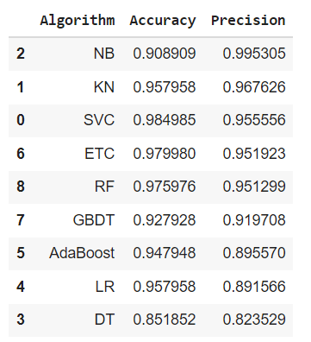
BEST PRECISION

Slide 14
From the Table we can clearly see that Multinomial Naïve Base is the best Algorithm to work with as it has the best Precision and Accuracy as compared to other Algorithms.

Slide 15
Using ANN based Classifier Models
Using Sigmoid Neuron:
Accuracy on training data: 97.95%
Testing Accuracy Score: 95.76%
Using SLP:
Accuracy on training data: 70.95%
Testing Accuracy Score: 69.76%
Using MLP:
Accuracy on training data: 70.95%
Testing Accuracy Score: 69.76%
Since the Accuracy and Precision scores were low I didn’t used these algorithms.

Slide 16
Creating Web App for the Model
Now as we Created the model I made a Web App for the same using Streamlit Library in Python.
Firstly, we have to pickle our model. Pickling the model helps to serialize the model to create a .pkl file which can be used to implement the model in other place. Here I used Scikit Library to pickle my model and used the .pkl file to create a web interface using streamlit and to finish things up Deployed the web app using Heroku. Here is a link to my Web App :
https://email-spam-by-gaurav.herokuapp.com/
For Source Code: https://github.com/gaurav2612gupta/ML_Project

Slide 17
Literature Survey
Article 1 : Email classification via intention-based segmentation
Link : https://sci-hub.mksa.top/ Date : Oct 2020
This paper proposes a novel dynamic spam filter model that considers the changes in the interests of users with time while handling the spam activities. It uses intention-based segmentation to compare different segments of text documents instead of comparing them as a whole. The proposed spam filter is a multi-tier approach where initially, the email content is divided into segments with the help of part of speech (POS) tagging based on voices and tenses. Further, the segments are clustered using hierarchical clustering and compared using the vector space model. In the third stage, concept drift is detected in the clusters to identify the change in the interest of the user. Later, the classification of ham emails into various categories is done in the last stage. For experiments Enron dataset is used and the obtained results are promising.

Slide 18
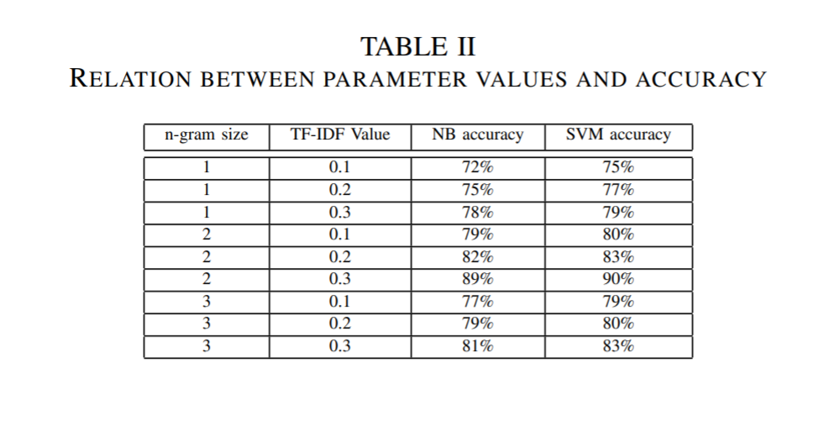

Slide 19
Article 2 : Feature Extraction aligned Email Classification based on Imperative Sentence Selection through Deep Learning
Link : https://iecscience.org/uploads/jpapers/202108/rvRUTTmGYo1MiJ86KpRHOop8SqW8HWawp2xvrkn0.pdf
Date : Aug 2021
In this research, we are introducing a methodology which classifies email text into three categories i.e. order, request and general on basis of imperative sentences. This research use Word2Wec for words conversion into vector and use two approaches of deep learning i.e. Convolutional neural network and Recurrent neural network for email classification. We conduct experiment on Dataset collected from Personal Gmail account and Enron which consists of 1000 emails. The experiment result show that RNN gives better accuracy than CNN. We also compare our methods with previously used method Fuzzy ANN results and Our proposed methods CNN and RNN gives better results than Fuzzy ANN. This research has also included different experimental result in which CNN and RNN applied on different ratios of training and testing dataset. These experiment show that increasing in the ratio of training dataset results in increasing accuracy of algorithm.

Slide 20
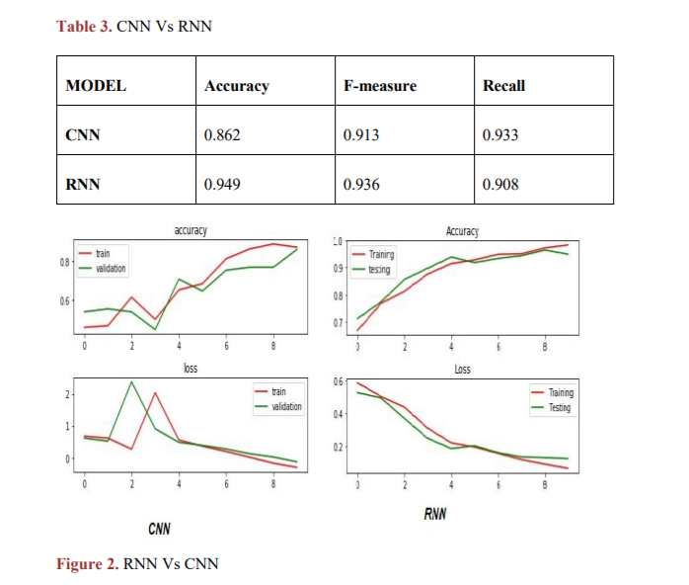

Slide 21
Article 3 : Email Classification Research Trends: Review and Open Issues
Link : https://ieeexplore.ieee.org/stamp/stamp.jsp?tp=&arnumber=7921698&tag=1
Date : June 2017
This paper comprehensively reviews articles on e-mail classification published in 2006–2016 by exploiting the methodological decision analysis in five aspects, namely, e-mail classification application areas, data sets used in each application area, feature space utilized in each application area, e-mail classification techniques, and the use of performance measures. A total of 98 articles (56 articles from Web of Science core collection databases and 42 articles from Scopus database) are selected. To achieve the objective of the study, a comprehensive review and analysis is conducted to explore the various areas where e-mail classification was applied. Moreover, various public data sets, features sets, classification techniques, and performance measures are examined and used in each identified application area. This review identifies five application areas of e-mail classification. The most widely used data sets, features sets, classification techniques, and performance measures are found in the identified application areas. The extensive use of these popular data sets, features sets, classification techniques, and performance measures is discussed and justified. The research directions, research challenges, and open issues in the field of e-mail classification are also presented for future researchers.

Slide 22
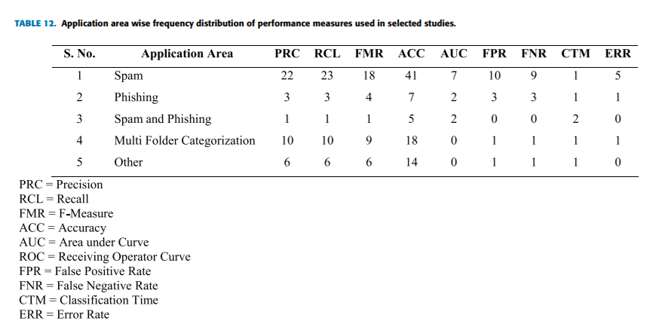

Slide 23
Article 4 : Classification Of Power Relations Based On Email Exchange
Link : https://sci-hub.mksa.top/ Date : Oct 2020
In this paper, we try to find out how interactions between two people show power relations between them by studying various research papers and comparing techniques used in them. Several features such as non-lexical, lexical, no. of recipient, were used in power level analysis. Deep learning techniques such as CNN, LSTM have been observed to give better results than traditional NLP methods. We have implemented our own power relation classifier by using the optimum technologies and improving on some of the drawbacks faced by the previous researchers. We have also implemented a four-way classification for the power hierarchy problem.

Slide 24
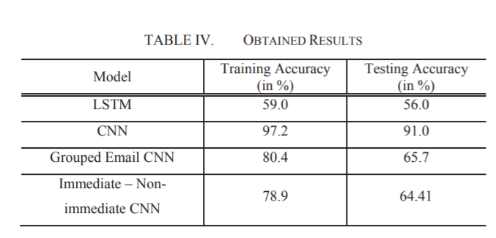

Slide 25
THANK YOU

